Slide 1
Unit 4
Don’t eat in class.
Section A 2a-2d
七年级(下)

Slide 2

Objectives
To learn to use can for permission
To learn to use modal verbs have to, must

Slide 3

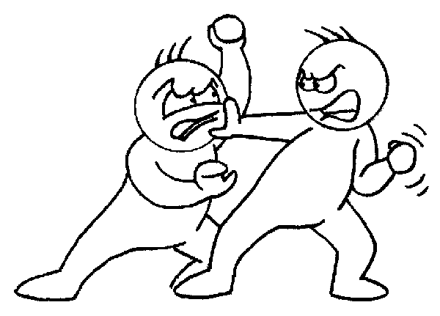
Tell your classmate what the rules should be.
Don’t fight with your classmates.

Slide 4
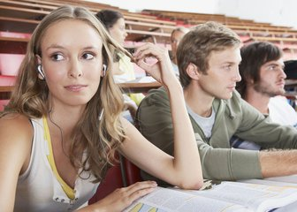
Don’t listen to music in the classroom.

Slide 5
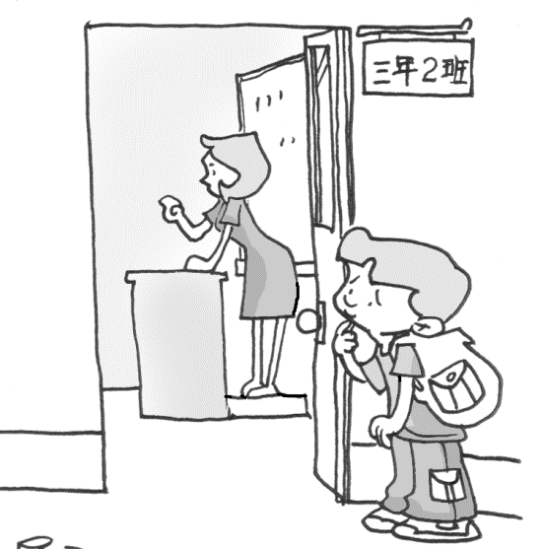
Don’t arrive late for school.

Slide 6
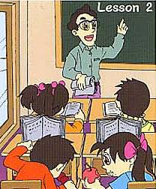
Don’t eat in the classroom. You must eat in the dining hall.

Slide 7
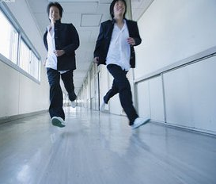
Don’t run in the hallways.

Slide 8


2a. Listen. Check the activities Alan and Cindy talk about.
Activity
1. ___ listen to music in the classroom or hallways | can | can’t
2. ___ listen to music in the music room | can | can’t
3. ___ listen to music outside | can | can’t
4. ___ eat in the classroom | can | can’t
5. ___ eat in the dinning hall | can | can’t
6. ___ eat outside | can | can’t
7. ___ wear a hat | can | can’t
8. ___ fight | can | can’t
√
√
√
√
√
√
√

Slide 9
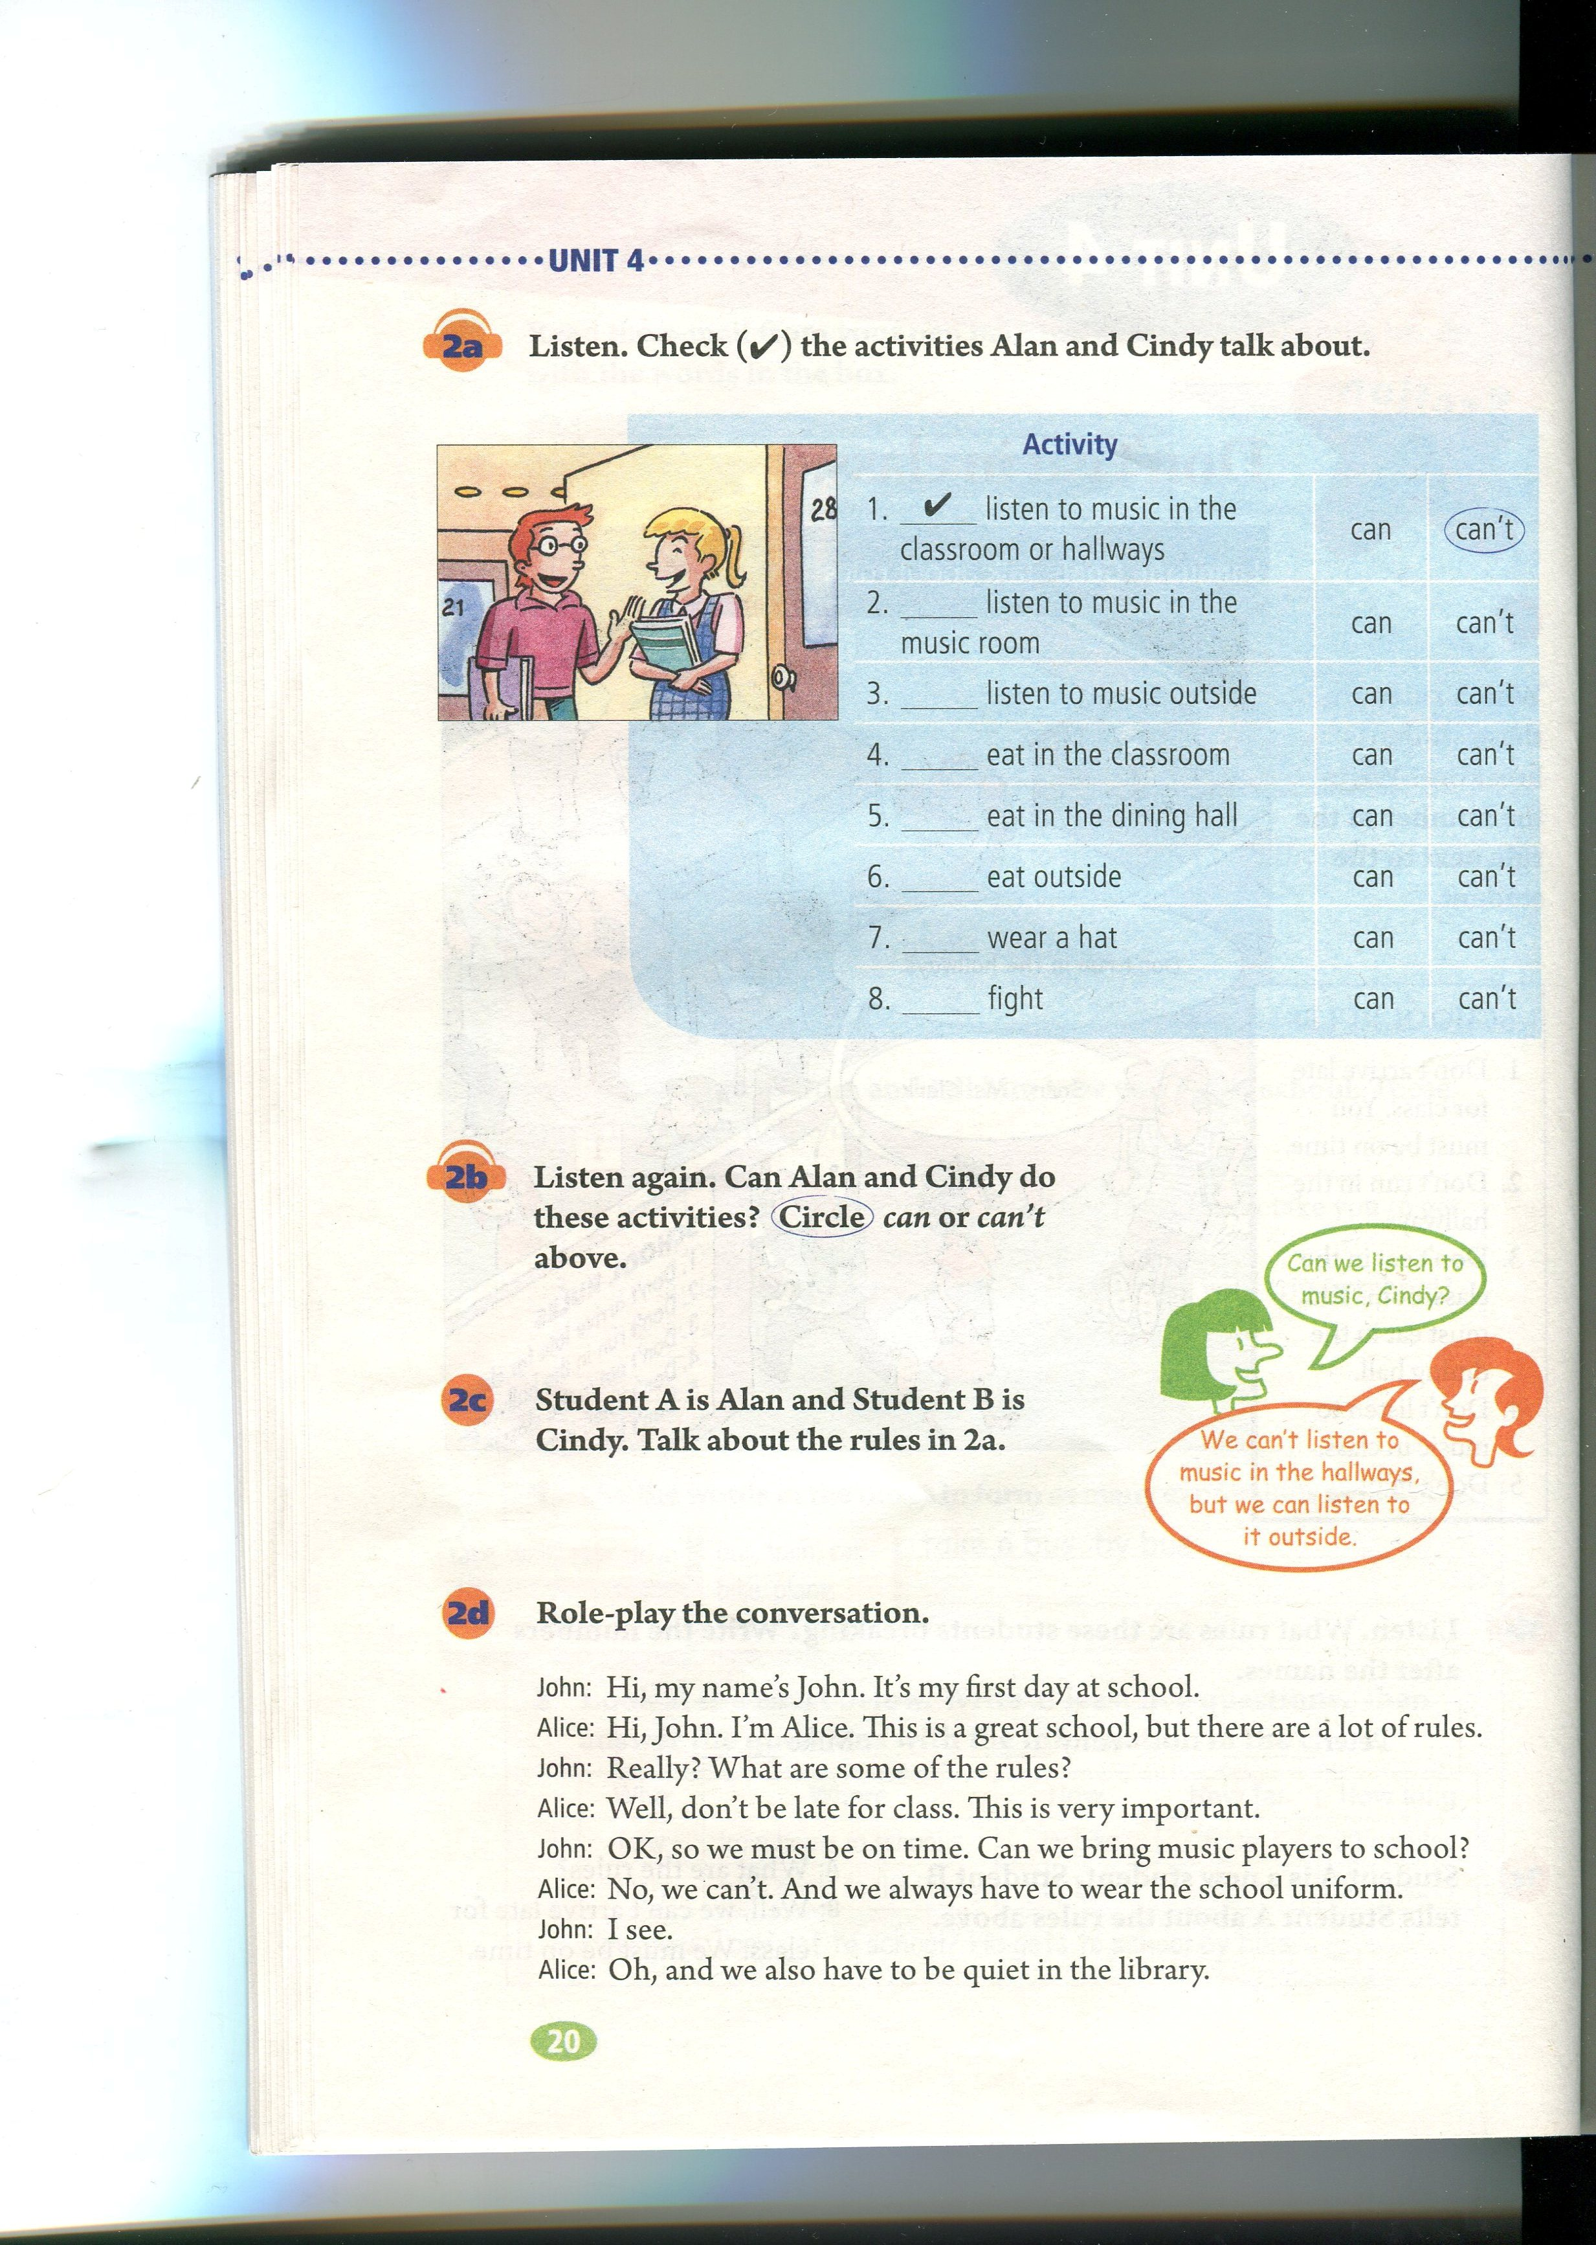
2b. Listen again. Can Alan and Cindy do these activities? Circle “can” or “can’t” above.

Slide 10
Check your answers!
Activity
1. ___ listen to music in the classroom or hallways | can | can’t
2. ___ listen to music in the music room | can | can’t
3. ___ listen to music outside | can | can’t
4. ___ eat in the classrooms | can | can’t
5. ___ eat in the dinning hall | can | can’t
6. ___ eat outside | can | can’t
7. ___ wear a hat | can | can’t
8. ___ fight | can | can’t
√
√
√
√
√
√
√

Slide 11
2c. Student A is Alan and Student B is Cindy. Talk about the rules in 2a.
A: Can we listen to music, Cindy?
B: We can’t listen to music in the hallways,
but we can listen to it outside.

Slide 12

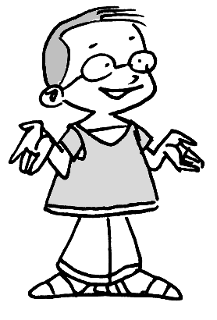
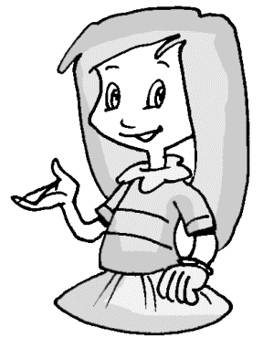
What are the school rules, Alan?
Well, we can’t listen to music in the classroom or hallways.
But we can listen to music in the music room.
We can’t eat in the classroom, but we can eat in the dining hall.
Uh-huh.

Slide 13
No, we can’t. What else? Oh, you can’t fight with your classmates. That makes the teachers really unhappy.
Oh. And can we wear a hat in class?
I see.

Slide 14
2d. Role-play the conversation.
John: Hi, my name’s John. It’s my first day
at school.
Alice: Hi, John. I’m Alice. This is a great
school, but there are a lot of rules.
John: Really? What are some of the rules?
Alice: Well, don’t be late for the class. This
is very important.
John: OK, so we must be on time. Can we bring
music players to school?

Slide 15

Alice: No, we can’t. And we always have
to wear the school uniform.
John: I see.
Alice: Oh, and we also have to be quiet in
the library.

Slide 16
Read the conversation in 2d and answer the questions.
Reading
1. Is John new at school?
___________
2. Are there many rules at school?
______________
Yes, he is.
Yes, there are.

Slide 17
3. Can he bring music players to school?
_______________
4. Do they have to always wear the school uniform?
_______________
No, he can’t.
Yes, they do.

Slide 18
Practice
Can we …?
Yes ,we can .
No, we can’t.
eat in class
listen to music outside
wear hats in school
fight in class
speak loudly in the
library

Slide 19
Language points
1. wear 意为“穿、戴”
My aunt wears a blue skirt and a white T-shirt.
我姑姑穿着蓝色的裙子，白色的T恤。
Does he wear glasses?
他戴眼镜吗？

Slide 20
2. have to与must
1) have to意为“必须做某事”强调“客观需要”
They have to wear school uniforms every day.
他们每天必须穿校服。
2) must 意为“必须”强调主观上的愿望
It’s late. I must go home now.
天晚了。我现在必须要回家。

Slide 21
练一练：用have to, must 填空
1. It’s cold outside. We ______ stay at
home.
2. We ____ be good with our parents.
have to
must

Slide 22
3. out, outside
out一般只用作副词, 意为“出去, 在外面”，
其反义词是in, 单独使用时, 不能接宾语，
若与一些动词连用, 才可接宾语。如:
Please take out your books.
outside可用作介词和副词, 意为“在……外
面/部”，指在某物体的外侧, 外部, 其反义词
是inside。如:
Let’s meet outside the school gate.

Slide 23
4. What else do you have to do?
else “其它的”, 用来修饰something, anything ,
nothing等, 还可用来修饰疑问词 what,
where, who等, else修饰疑问词或不定代词时,
应后置。例如:
Do you have anything else to do？
Who else did you see?

Slide 24
Quiz

Slide 25
一、把下列祈使句改成否定句
1. Sit down.
2. Come in.
3. Eat at home.
Don’t sit down.
Don’t come in.
Don’t eat at home.

Slide 26
4. Listen to music outside.
5. Do your homework at school.
Don’t listen to music outside.
Don’t do your homework at school.

Slide 27
二、 用have to或has to填空
have to
1. We _______ clean our classroom after school.
2. She _______ make her bed after getting up.
3. It’s late. Mr. Beckman _______ go to
work by car.
4. Emily and Peter join a music club.
They ________ practice guitar every day.
has to
has to
have to

Slide 28

三、将下列句子译成英语。
不要在上课时听音乐。
__________________________
2. 我们必须准时。
___________________________
3. 我们能把音乐播放器带到学校里来吗？
___________________________________
在图书馆里我们必须保持安静。
________________________________
不要在楼道里跑 。
_________________________________
Don’t listen to music in class.
We must be on time.
Can we bring music players to school?
We must keep quiet in the library.
Don’t run in the hallways.

Slide 29
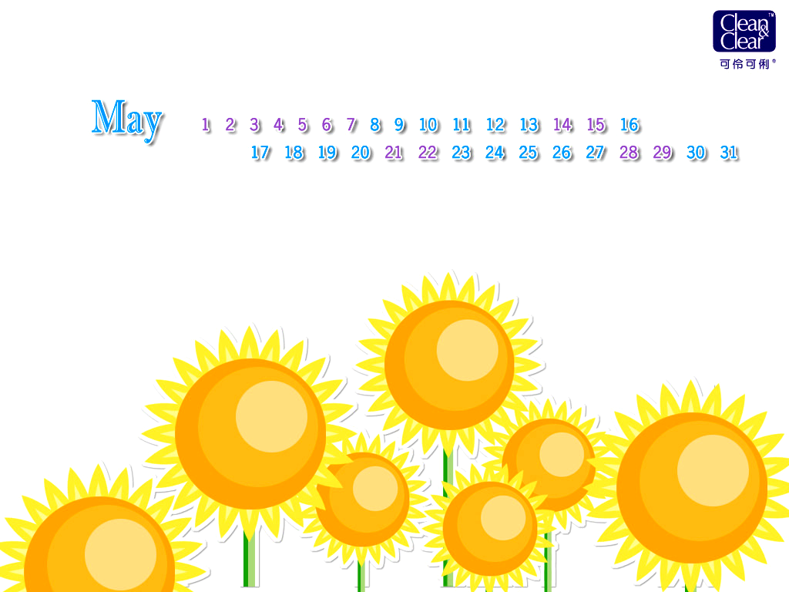
Homework
Write down more rules you know
in your school. (at least 5)

Slide 30
Thank You!

